Slide 1
Mood and Motivation Detection with Facial Emotion Recognition
Prepared By:
2015510026 İbrahim Erhan
2015510071 Vuslat Yolcu

Slide 2
Presentation Outline
Introduction
Problem Definition
Purpose of the Project
Literature Review/Similar Projects
Project Requirements
Project Design
Project Implementation
Tests and Results
Conclusion

Slide 3
Introduction
Facial emotion recognition is used for the detection of people’s mood and motivation
The data came from cameras is used for the facial emotion recognition and each person’s emotion is classified.

Slide 4
Problem Definition
The emotions, which are not properly controlled and tracked, may decrease the productivity of the work environment, especially in the workplace.
It is very important to follow the emotions by the managers or authorized persons in order to eliminate the occurrences and to predict future situations.

Slide 5
Purpose of the Project
The project's goal consists of training a convolutional neural network with labeled images of static facial emotions.
The network trained by the convolutional neural network are used as part of software to detect emotions in real-time.
The aimed to perceive the mental, and physical conditions of employees such as happiness, sadness, anger, fatigue, and insomnia.

Slide 6
Literature Review
The processes are done by the similar projects are reviewed and the observed processes are listed:
Preprocessing of input images
Feature Extraction
Facial expression recognition and classification
The main reason for the difference between similar projects, articles or other published papers is related to how the methods they use or develop.

Slide 7
Project Requirements Functional Requirements
Hardware Requirements
Camera
Software Requirements
Dlib Library
Opencv Library
Tensorflow Library
Form Application
MongoDB, PostgreSQL

Slide 8
Project Requirements Non Functional Requirements
Obtaining images from the camera
Sending images to the server
Classification of the images retrieved from the server

Slide 9
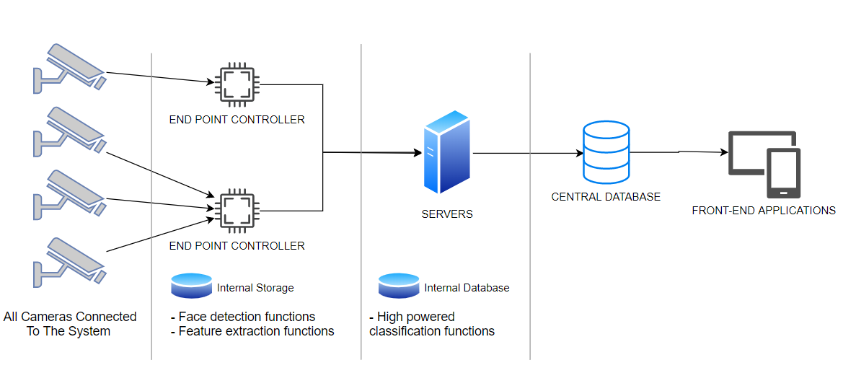
Project Design Architectural View

Slide 10
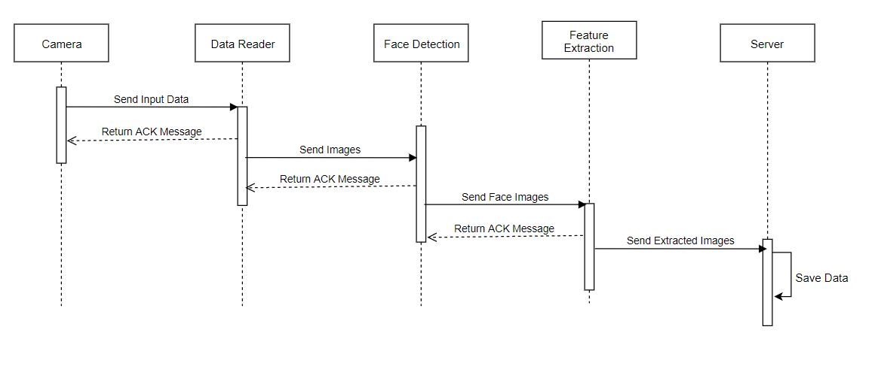
Project Design Sequential Diagram of the Project

Slide 11
Project Implementation
Face Detection Implementation
Facial Emotion Detection
Model Evalution and Results
MongoDB Deployement
PostgreSQL Deployment
Simulating the Data Flow and Database Connections

Slide 12
Project Implementation Face Detection Implementation
CNN based face detector from dlib library is used for face detection
Before using it, for different algortihms and libraries are evaluated and CNN based face detector is the most successful one for the face detection.

Slide 13
Project Implementation Facial Emotion Detection
For facial emotion detection a model trained
Fer2013 Dataset is used to train the model
The size of te images are 48x48 px
The dataset contains 35.887 images
It is a gray scale dataset
For 7 distinct facial expressions are classified
65% accuracy is obtained by using CNN algorithm by using Fer2013 dataset

Slide 14
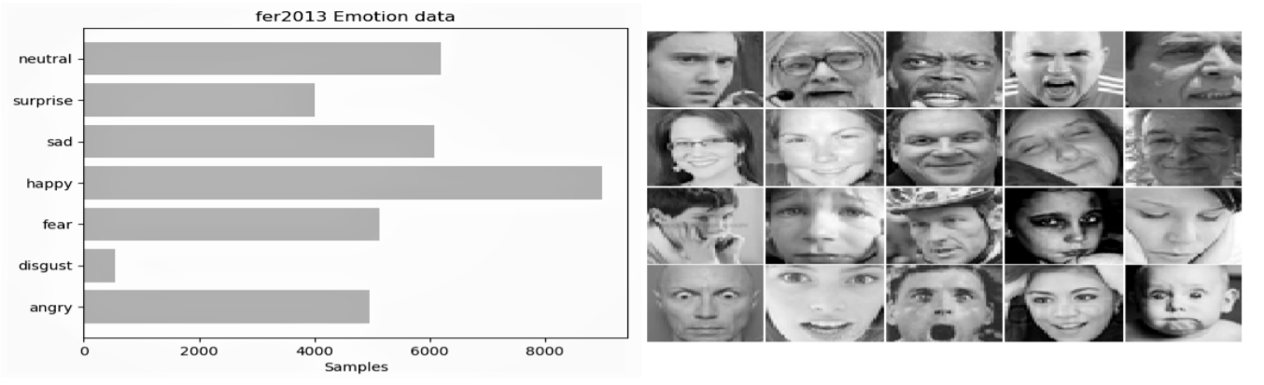
Fer2013 Dataset is used to train the model
The size of te images are 48x48 px
The dataset contains 35.887 images
It is a gray scale dataset

Slide 15
Project Implementation Facial Emotion Detection
To train a model CNN algorithm is used
Library: Tensorflow Keras
Activation function: ReLU
Batch size: 64
Number of epochs: 100
Layer Structure:
Input Layer
Convolutional Layer
Pooling Layer
Dense Layer
Output Layer

Slide 16
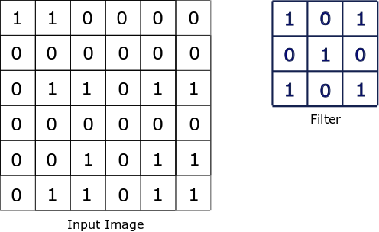
Project Implementation Facial Emotion Detection/Layer Structure
Input Layer
Initial dimensions are defined in this layer
First layer of modeling
It is a convolutional layer as well.

Slide 17
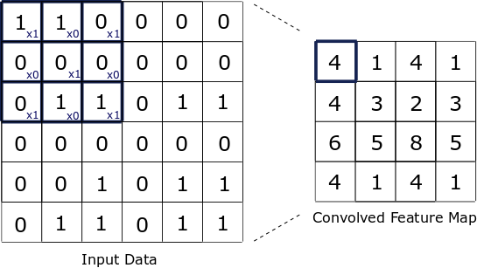
Project Implementation Facial Emotion Detection/Layer Structure
Convolutional Layer
Main component of the CNN model
Consist of three convolutional layers each focuses on different features such as vertical lines, horizontal lines and corners
The shapes in the face pictures are perceived better.

Slide 18
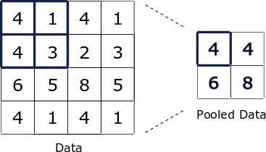
Project Implementation Facial Emotion Detection/Layer Structure
Pooling Layer
Decreases the computing power
Comes after each convolution layer

Slide 19
Project Implementation Facial Emotion Detection/Layer Structure
Flattening Layer
The volume of the data up to this stage decreases to 4x4x128, and when this point is reduced to a single dimension, a 2048 array is obtained (4x4x128 = 2048).

Slide 20
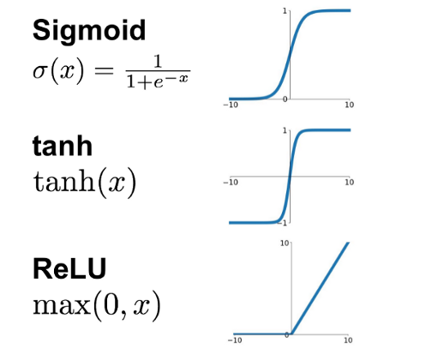
Project Implementation Facial Emotion Detection/Layer Structure
Dense Layer
It is a hidden layer
There are 1024 nodes
Activation function is applied in this layer
ReLu is used as a activation function

Slide 21
Project Implementation Facial Emotion Detection/Layer Structure
Output Layer
Last layer
There are 7 neurons to determine each emotion class
The Softmax activation function converts the output values scales into 0-1. Takes the largest value as a result

Slide 22
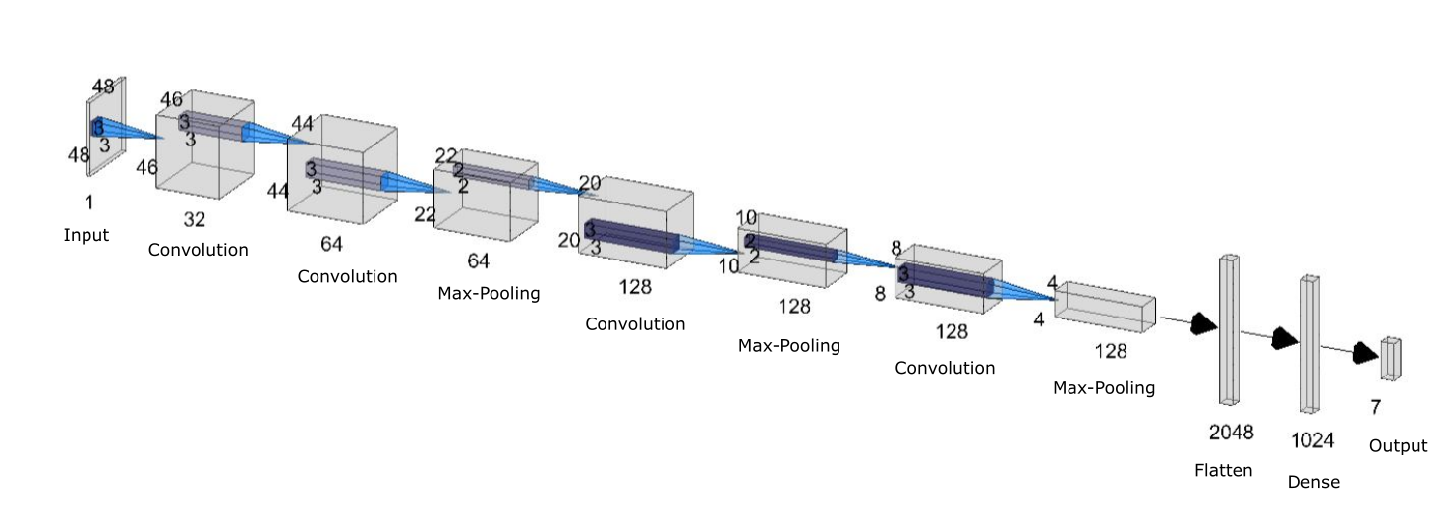

Slide 23
Project Implementation MongoDB Deployment
The unclassified cropped face images stored into MongoDB
The features can be summarized as followings
Features: The stored data
CameraID: Id of the camera
ClusterID: The group of the camera
Date: The date of the data received

Slide 24
Project Implementation PostgreSQL Deployment
The face images are classified and labeled in Classification Server
The labeled face images which are classified by the classification server are stored into the Postgre server.
The stored data is
Camera id
Cluster id
Emotion label
Capture date

Slide 25
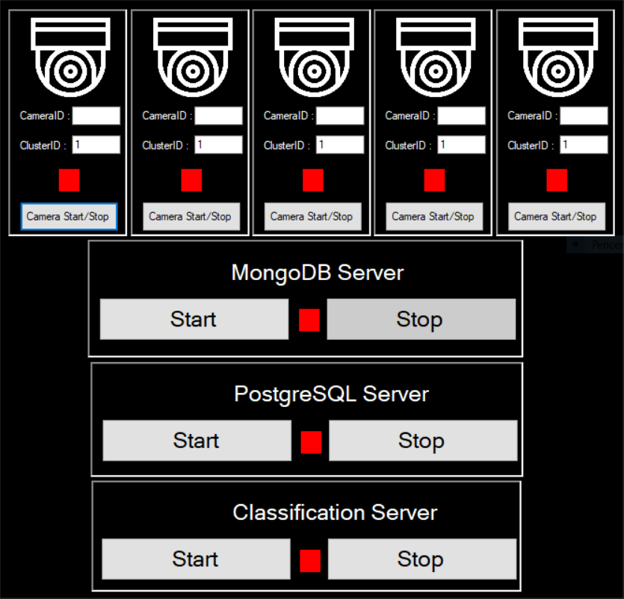
Project Implementation Simulating Data Flow and Database Connections
Starting the data flow and run the parts of the system separately
The aim here is both to be the basis for the admin side of the system and to speed up the developer's work by automating the execution of the necessary programs during the development stages.

Slide 26
Tests and Results Experiments of Face Detection Algortihms
Haar Classifier
DNN
Dataset | Total # of face images | Total # of non-face images | TP | FN | TN | FP | Accuracy | F-mesaure | Rate (img/s)
UTKFace | 23707 | 3000 | 3127 | 20581 | 2886 | 114 | 22.50% | 23.20% | 143.62
Jaffe | 213 | 3000 | 213 | 0 | 2886 | 114 | 96.45% | 78.88% | 52.85
FER2013 | 35887 | 3000 | 785 | 35102 | 2886 | 114 | 9.44% | 4.26% | 292.38
Dataset | Total # of face images | Total # of non-face images | TP | FN | TN | FP | Accuracy | F-mesaure | Rate (img/s)
UTKFace | 23707 | 3000 | 23680 | 28 | 2029 | 971 | 96.26% | 97.93% | 22.53
Jaffe | 213 | 3000 | 213 | 0 | 2029 | 971 | 69.77% | 30.49% | 22.63
FER2013 | 35887 | 3000 | 35599 | 288 | 2029 | 971 | 96.76% | 98.26% | 22.24

Slide 27
Tests and Results Experiments of Face Detection Algortihms
Hog
CNN
Dataset | Total # of face images | Total # of non-face images | TP | FN | TN | FP | Accuracy | F-mesaure | Rate (img/s)
UTKFace | 23707 | 3000 | 22868 | 839 | 2926 | 74 | 95.54% | 97.43% | 2.24
Jaffe | 213 | 3000 | 213 | 0 | 2926 | 74 | 97.69% | 85.20% | 0.3
FER2013 | 35887 | 3000 | 24913 | 10974 | 2926 | 74 | 71.58% | 81.85% | 1.73
Dataset | Total # of face images | Total # of non-face images | TP | FN | TN | FP | Accuracy | F-mesaure | Rate (img/s)
UTKFace | 23707 | 3000 | 23583 | 125 | 2922 | 78 | 99.23% | 99.57% | 169.57
Jaffe | 213 | 3000 | 213 | 0 | 2922 | 78 | 97.57% | 84.52% | 365.89
FER2013 | 35887 | 3000 | 31132 | 4755 | 2922 | 78 | 87.57% | 92.79% | 292.64

Slide 28
Tests and Results Experiments of Facial Emotion Detection Algortihms
Two popular algorithms are tested which are SVM and CNN
The model trained by SVM for 7 different emotions accuracy is 50%
The model trained by CNN for 7 different emotions accuracy is 65%
That is why the model trained by CNN is chosen

Slide 29
Conclusion
The purporse of the application is to establish the classification according to the face emotions by processing the visual information that it reads from camera.
According to similar projects the most suitable algorithms and methods are detected
The detected methods are tested before implementing on the project
After then collected data from camera and making face detection is carried out
Recognition of emotions from captured faces and storing them into the database and retrieving is accomplished
As a result, this system accomplished 65% accuracy for detecting 7 different emotions.
The classfied faces are stored in the database are ready for future appliacations

